Slide 1
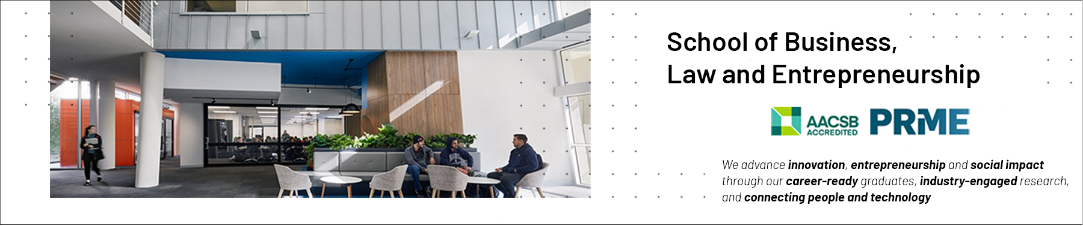
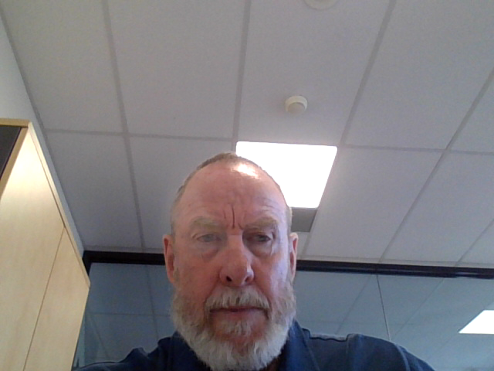
Ethics as a Core Professional Competency
School of Business, Law and Entrepreneurship
Online Learning Materiel

Slide 2


This session’s roadmap
What we will be covering.
An overview of ethics as it pertains to the ICT industry (applied)
Morals, Virtues, Values/ value systems
Ethical principles / theories
Good/Clean/Fair ICT
Ethical decision making
Professional codes of conduct and ethics

Slide 3
Objectives of the Ethics Module(s)
Objectives of the ethics module(s):
Demonstrate a basic knowledge of ethical standards and theories,
Apply ethical standards or theories in case studies to interpret and evaluate ethical behaviour in the use and design of Information Technologies,
Explore topical ethical issues impacting on ICT professionals,
Critically reflect on ethical choices by self and others; and,
Have a clear understanding of required ethical behaviour in the ICT Industry (Professional Codes of Conduct)

Slide 4
This session’s ULOs
Unit Learning Outcomes (ULOs).
2. Evaluate the role of standards, codes of conduct and legislative/regulatory obligations on the level of professionalism of the ICT industry
3. Review the roles and responsibilities of ICT professionals in organisations and society from a range of perspectives such as work-life balance, mentoring and life-long learning
What you need to do with this recorded presentation.
Watch, reflect and prepare for the on-campus face-to-face class
How long will this task take.
This task (the 3 video presentations) will take approx. 45 minutes to complete.

Slide 5


Slide 6
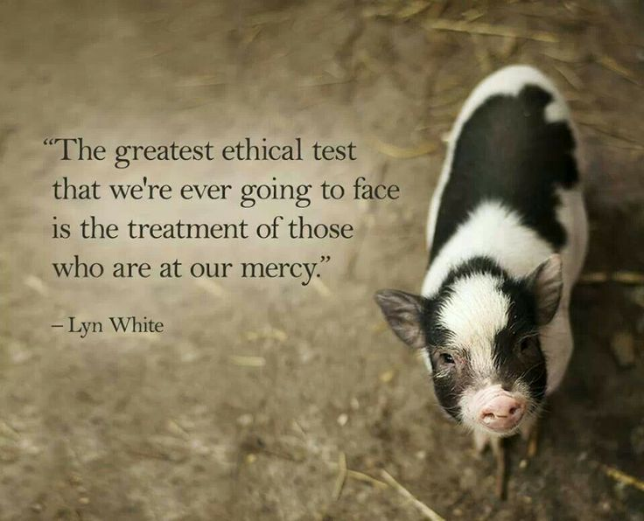
Notes:
6
So - ethics?
Ethics and morality are relevant at all levels of society.
Ethics is commonly understood as being concerned with issues and questions of responsibility when our actions affect others, it is (or should be) a critical structured evaluation of how we should behave when what we do impacts on others.
Within this there are two important processes –
firstly, that ethics has to do with critically examining particular norms and behaviours, and asking which ones matter more in what sorts of situations and secondly,
that ethics is more than simply having an opinion about how we should behave. Ethics has to do with a structured process of rationalizing and justifying our behaviour based on some higher order principles. These higher order principles provide us with guidance as we make ethical choices.
Professionals provide services that affect our welfare – and the decisions that we make as computer scientists, engineers etc. all impact on others. Introducing an ethical framework into a professionals decision-making processes, establishing professional standards of behaviour are important. Where the impact of our work, where the outcomes of what we do, can impact on others, we need to think about how we come to those decisions.
Ethical decision-making, in terms of making the right decision, carefully considering the outcomes of one's actions, is a core competency of professional working life.
This is even more relevent in technology where development is occurring so broadly and so quickly, we as a society have had very little time to start developing moral approaches to the governance of technology and how it impacts our lives. Regulation, governance and the law lags behind technological development – which means that technology is developing in a moral vacuum – and we are reliant, to a large extent on our values to try and determine what is right and what is wrong.
Ethics is more than simply having an opinion about how we should behave. Ethics has to do with a structured process of rationalizing and justifying our behaviour based on some higher order principles. These higher order principles provide us with guidance as we make ethical choices.

Slide 7
Ethics / Defined
Ethics is defined as the moral principles that govern a person's behaviour or the conducting of an activity (Oxford Dictionary 2021)
The terms ethics and morality are closely related.
Morals are defined as relating to the standards of good or bad behaviour, fairness, honesty, etc. that each person believes in, rather than to laws.
Both values and judgments play a critical role when we make ethical decisions.
Abusive behaviour, harassment, accounting fraud, conflicts of interest, defective products, bribery and employee theft are all problems cited as evidence of declining ethical standards.

Slide 8
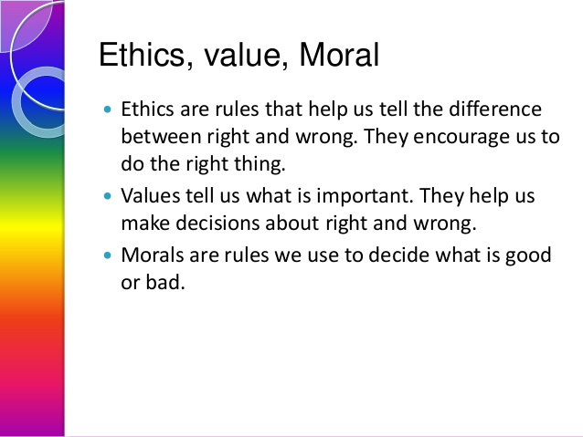
Ethical Concepts

Slide 9

What Ethics is NOT
Ethics is not just about religion – although religious values inform ethical stances
Ethics is not a set of prohibitions – also positives
Ethics is not a simple system. There will always be situations where simply following the “rule” is not the best thing to do
What is Right or Wrong is not always clear
All shades of grey appear from different perspectives

Slide 10
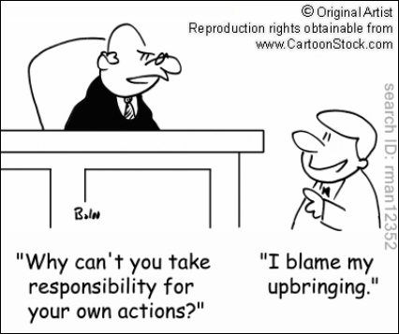
Ethical Influence/r/s
Nature vs. Nurture debate
3 ‘codes’ of influences on your ethical stances
Your own personal code (itself influenced by family, community, ethnic and cultural background, religion, etc.)
Any informal code of ethical behavior that exists in the workplace
Exposure to formal codes of ethics

Slide 11


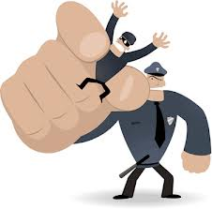


Why should business CARE about Ethics?
Risk is the product of multiplying the likelihood of an event by the impact of its occurrence
One major risk for an organisation is that its employees (or Board) might engage in unethical practice – the consequences of which, if discovered, may be catastrophic (subject to punitive damages)
Risks associated with inappropriate behaviour have increased due to:
Globalisation
Heightened vigilance by
Employees
Shareholders
Regulatory agencies
Desperation when under severe business stress

Slide 12
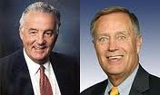
Sarbanes Oxley
An act of US Congress (2002), setting new or enhanced standards for all U.S. public company boards, management and public accounting firms
Named after the two reps who proposed it
Senator Paul Sarbanes (Dem)
Rep Michael Oxley (Rep)
Enacted in response to public outrage over several major accounting scandals (next slide)
Section 404 requires that the CEO and CFO sign any SEC filing to attest to its accuracy
As a consequence, ICT organisations, under instruction from boards, must build controls that ensure information stands up to audit scrutiny

Slide 13

(Some) Ethical Scandals
Enron
Volkswagen
Lehman Brothers
Uber
Apple
BP
Facebook
Valeant Pharmaceuticals
Kobe Steel
Equifax

Slide 14
Why fostering ‘good’ ethics in business is important
To gain the goodwill of the community
To create an organisation that operates consistently
To protect the organisation and its employees from legal action
To avoid unfavourable publicity
Suppliers and other business partners prefer companies that operate in a fair and ethical manner
Corporate Social responsibility (CSR)
Triple bottom line, People/Planet/Profit
Bad ethics can lead to bad business results

Slide 15
Summary
Ethics addresses the following: “What do people think is right?” “What does ‘do the right thing’ mean?” “How should people act?” “What rules or laws should we have?”

Slide 16


